Slide 1
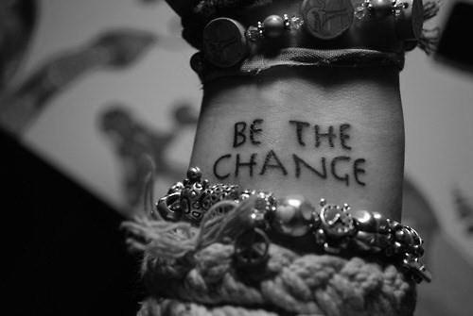
Art on Elections 2016
The Center for Conflict Management at the University of Akron invited Akron K-8 students to create a piece of art that expressed their thoughts about the presidential election we are witnessing this year.
We received amazingly creative and thoughtful submissions and want to express our deep appreciation to all the students and teachers who participated.
Congratulations to the winner, Megan Diulus, who has a $1000 scholarship from the Center waiting for her when she is ready to enroll at UA someday and whose submission will now become a part of the Center’s Student Art Gallery!

Slide 2
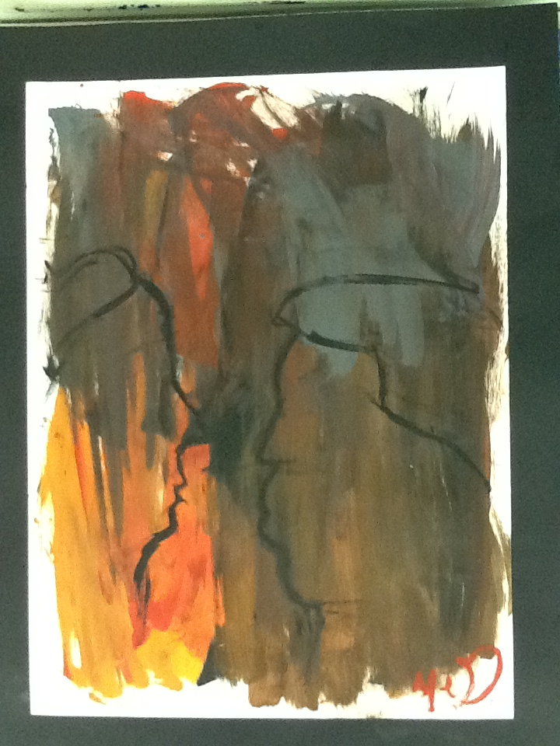
First Place Winner
Megan Diulus, Grade 6

Slide 3
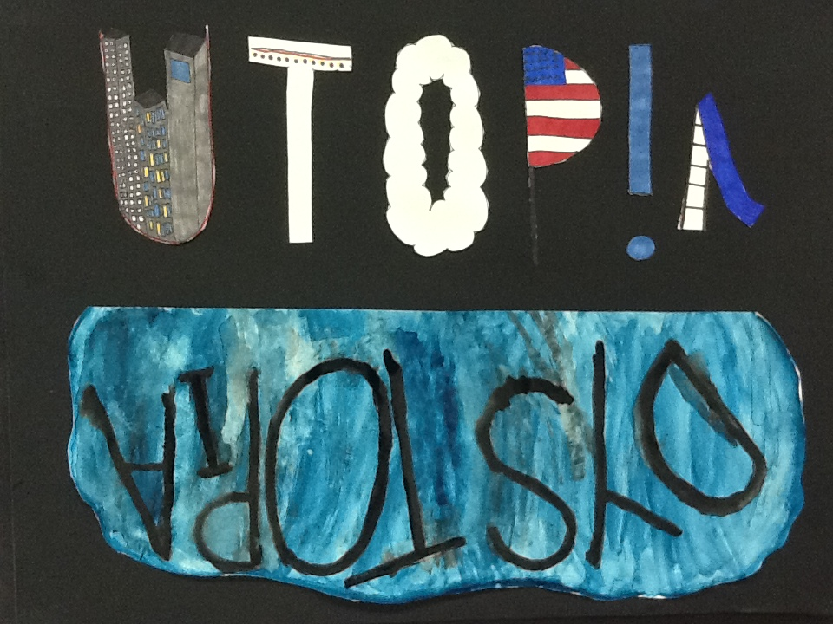
Second Place Winner
Talia Reiss, Grade 7

Slide 4
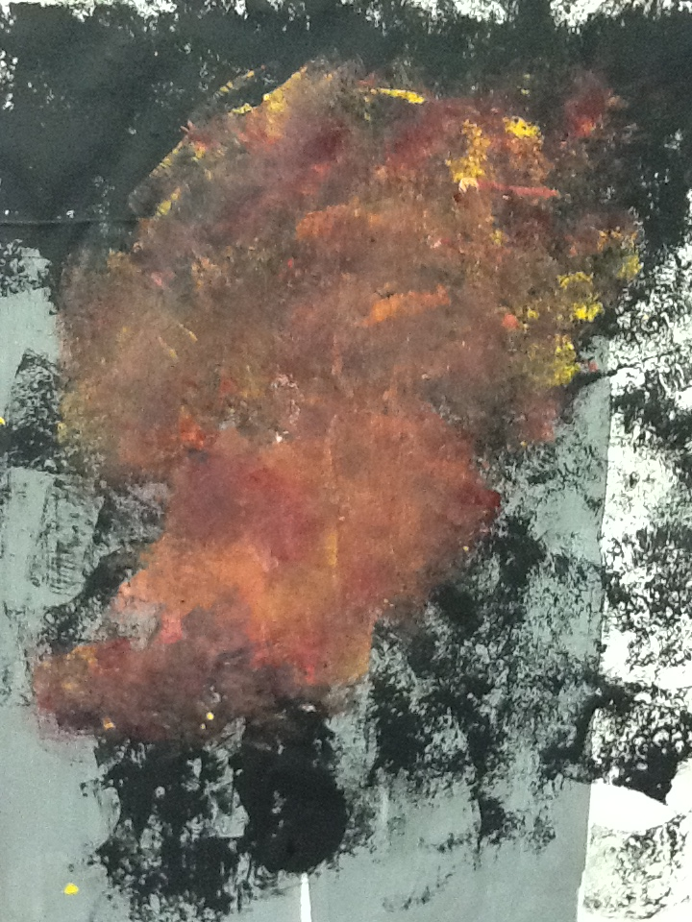
Third Place Winner, Kimora Greenwood Grade 6

Slide 5
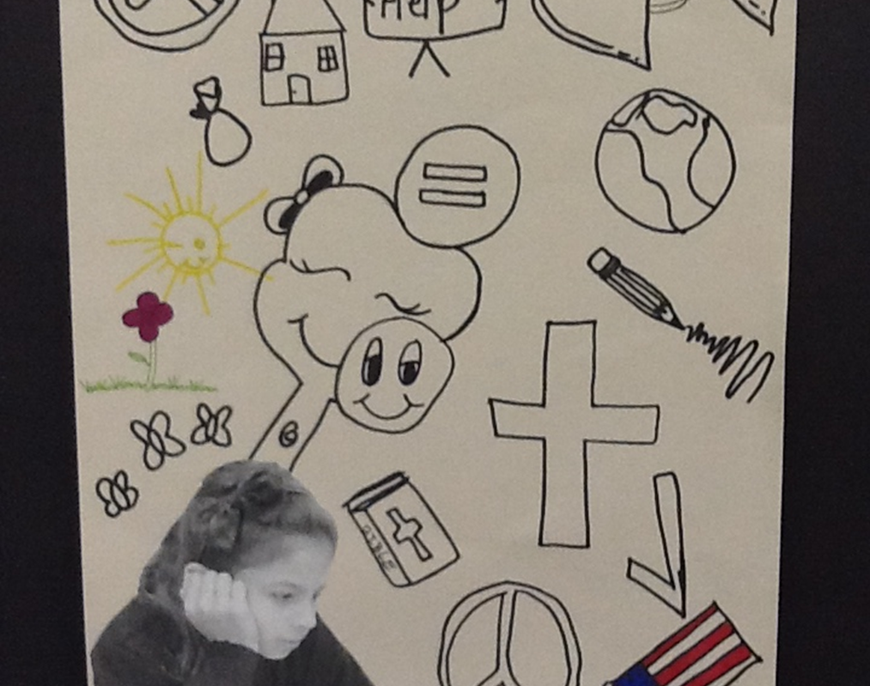
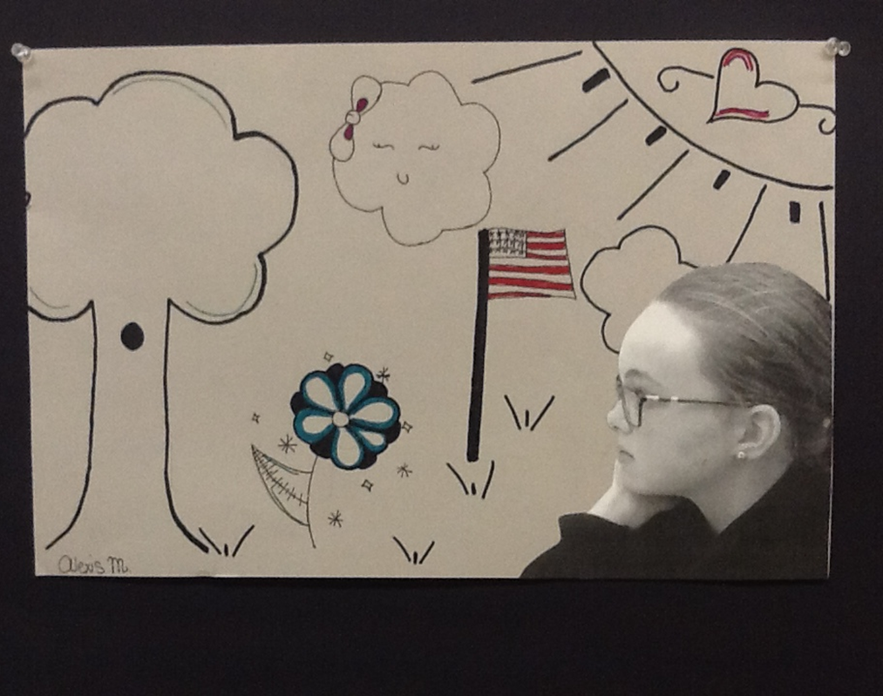
Priya, Grade 5 Alexis, Grade 5

Slide 6
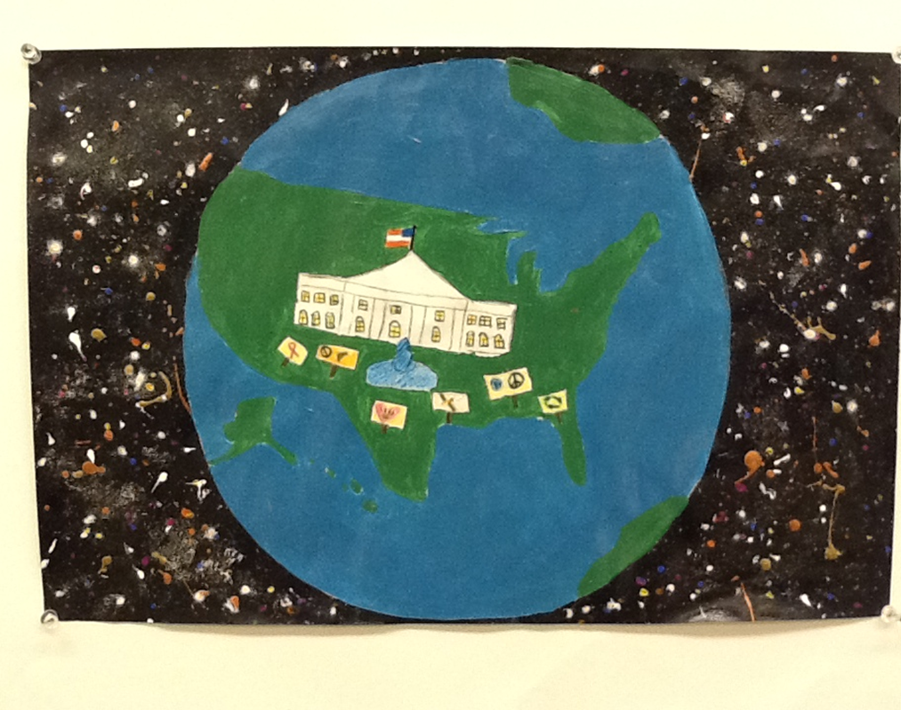
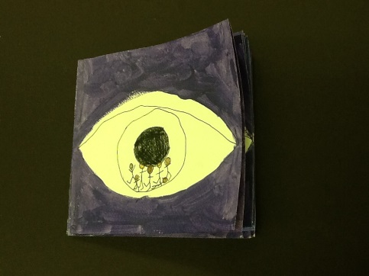
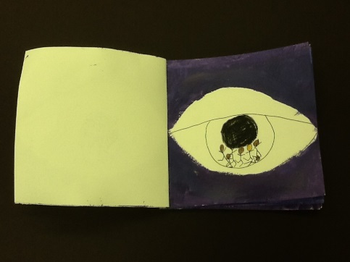
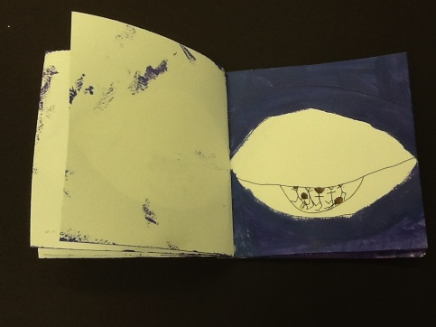
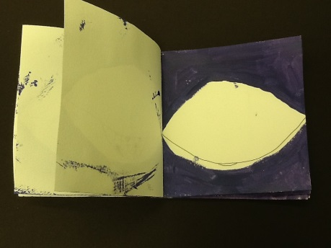
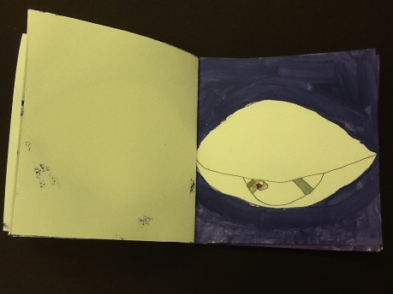
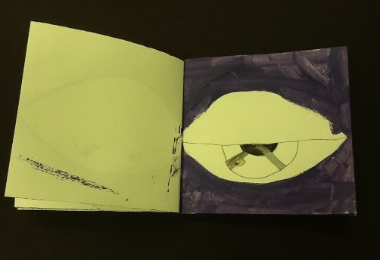
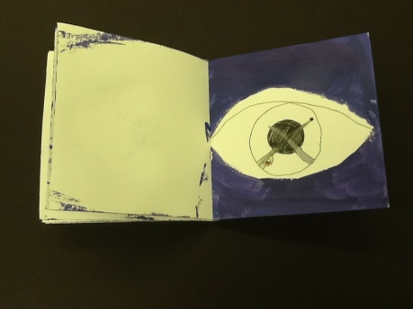
Sophie, Grade 7 Laney, Grade 7

Slide 7
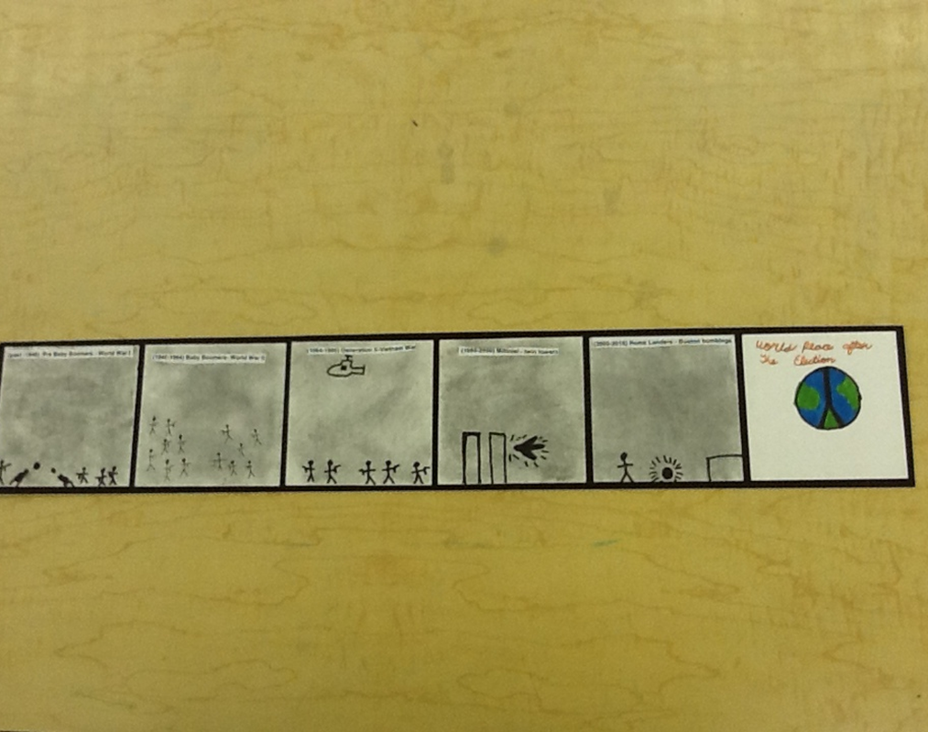
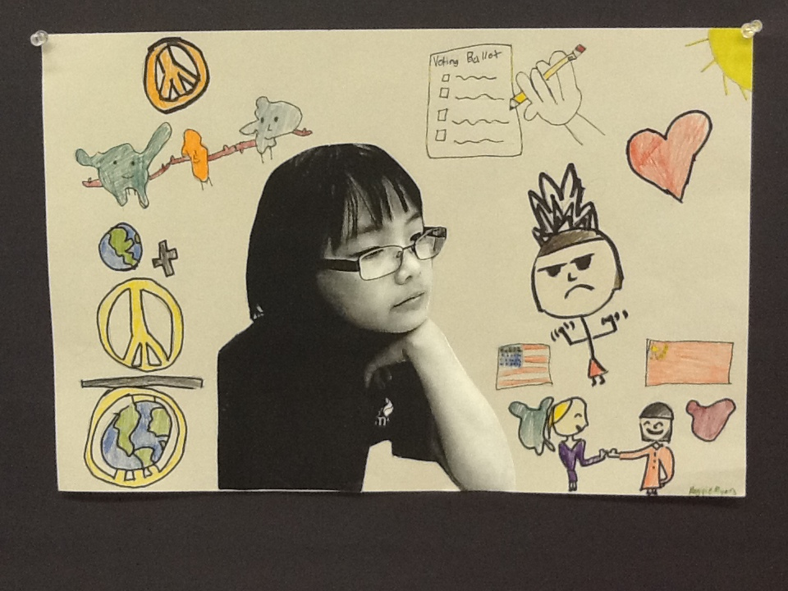
Molly, Grade 7 Maggie, Grade 5

Slide 8
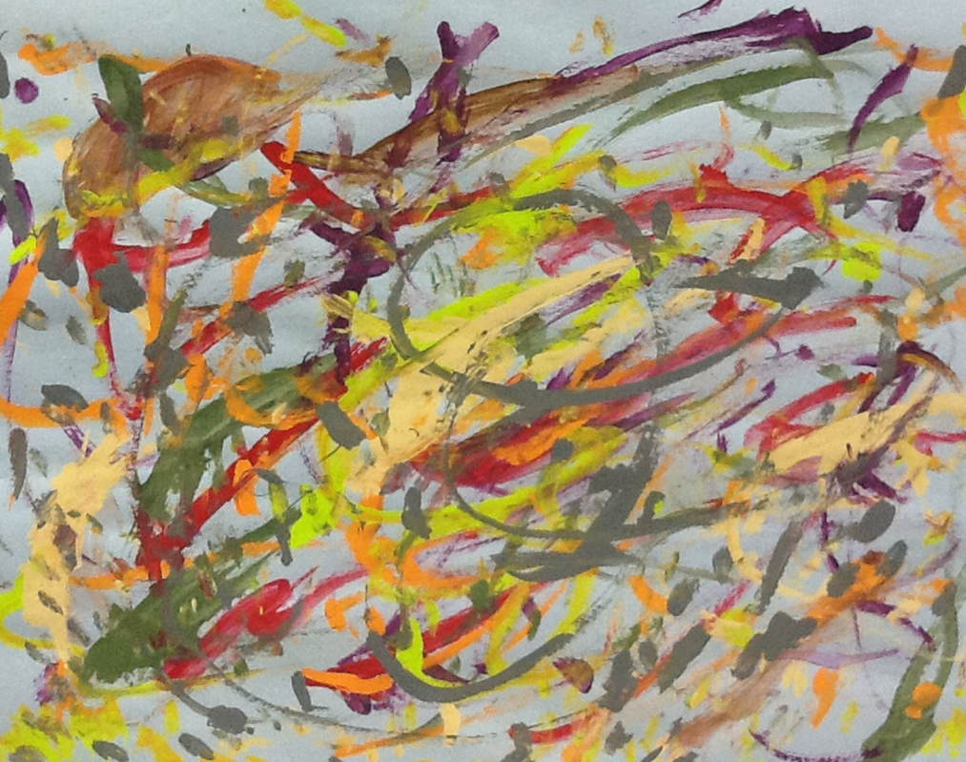
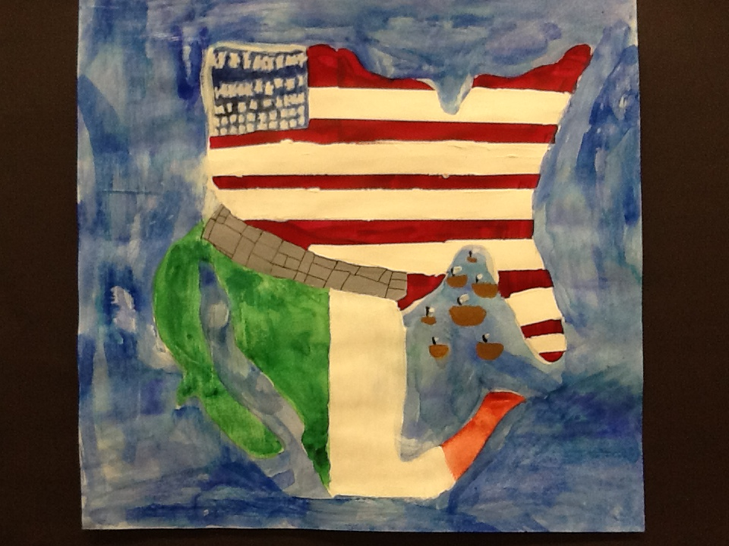
Jayla, Grade 6 Grace, Grade 7

Slide 9
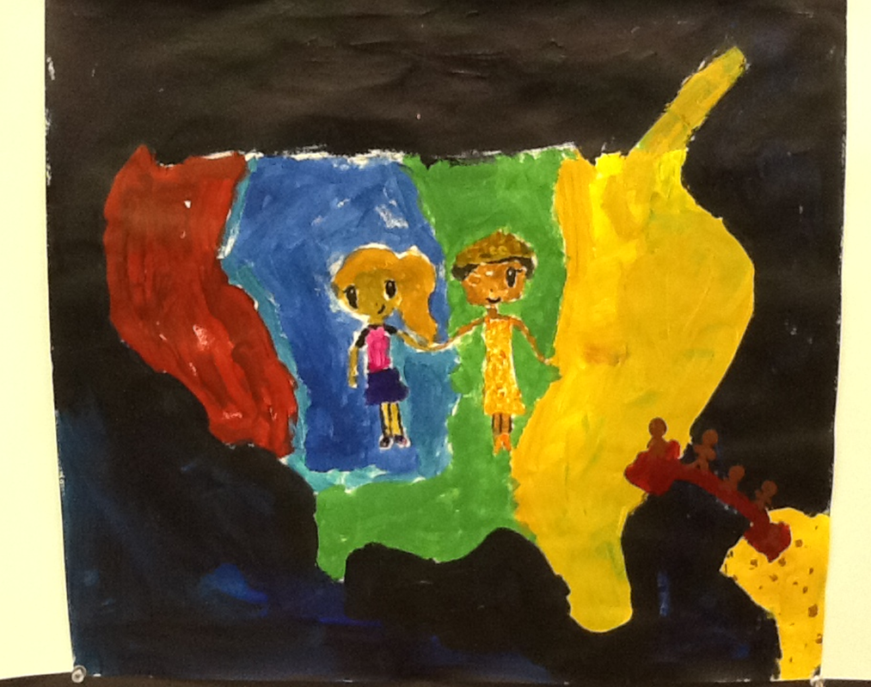
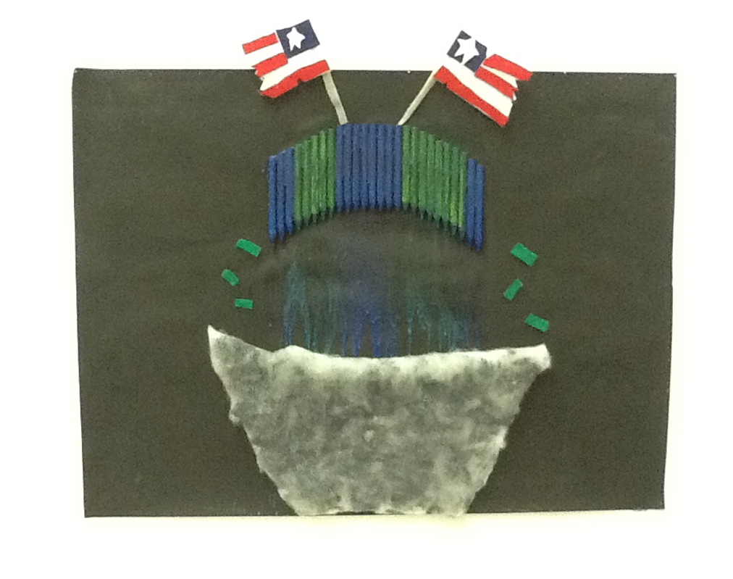
Teresa, Grade 7 Elizabeth, Grade 6

Slide 10
Art on Elections
Description
The Center for Conflict Management is soliciting student art in response to one or more of the prompts below with a focus on the current election cycle. This work will speak to the importance of citizen engagement and democratic decision making to address the challenges and conflicts faced by average Americans in our communities and our families every day.
The Center for Conflict Management is proud to have an art gallery on campus at The University of Akron and would like to include the selected work as a part of its permanent collection.
Ten finalists will be selected by the leadership team of the Center for Conflict Management and the winning student will receive a plaque and a $1,000 scholarship to The University of Akron. The scholarship will be held in their name until they enroll at UA — even if that is 10 years from today!
The Process
All students in grades K-8 are able to submit a piece. Visual mediums accepted: ceramics, drawing, painting, sculpture, printmaking. (Younger students are enthusiastically encouraged to work with their teachers on their submission and interpreting the prompts below.)
Students should create a piece based on one of the following prompts:
• Envision your world after the Presidential election. How will it have changed?
• Why is it important for people to participate in the election by voting this year?
• Show us the world you hope the new president will help to create.
Steps
Create a piece and a brief description of how it addresses one of these prompts no later than Monday, October 3, 2016.
Email your description, a description of the process/medium used, and photographs of your piece to Dr. Lyons at wtlyons@uakron.edu before 5:00 p.m. Monday October 3, 2016.
Dr. Lyons and his staff will identify the top ten projects and invite those artists to join the other finalists at the Center for Conflict Management Art Gallery on Friday October 14, 2016 at 4:00. Artists who are unable to attend are still eligible to have their piece selected.
The final selection will be made and announced publicly by Monday October 17, 2016.

